Slide 1

Physics-Informed Neural Networks (PINNs) a deep learning approach to differential problems
Giulio Pettenati,
Rita Ortese,
Michela Sbuelz
Deep Learning, Professor. Alessio Ansuini
Università degli studi di Trieste
ACADEMIC YEAR 2024/2025

Slide 2
PINNs-Introduction to our work
First-part(Michela):
What are PDEs and ODEs
Modelling real phenomena with PDEs and ODEs
Second-part(Giulio)
Solving Differential Equations with simple NNs
Introduction to PINNs
Confrontation
Third-part(Rita)
Limitiatipns of classical solvers
Three kind of problems PINNs can solve
Fourth-part
Our work about the paper: Using Physics-Informed Neural Networks for Modeling Biological and Epidemiological Dynamical Systems

Slide 3
Physics – informed neural networks
Employ neural networks to solve PDEs
Processes that produce natural phenomena can be described with PDEs

Slide 4




PDEs
ODEs

Slide 5
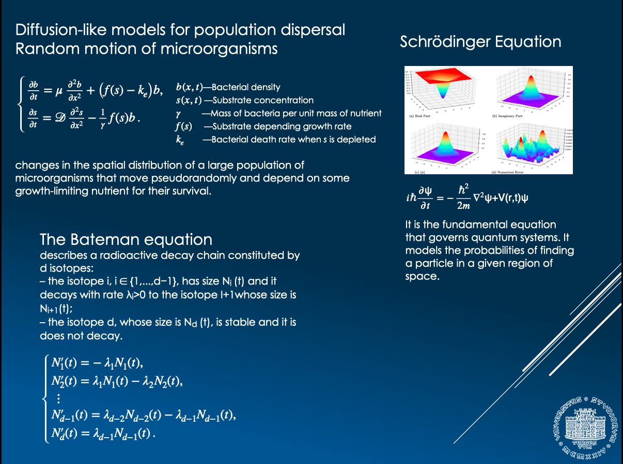

Slide 6

Numerical methods for ODEs and PDEs
PDE
Finite difference, finite element, finite volume...
ODE
One/Multi Step Methods, Implicit/Explicit (Euler, RK, BDF…)
INPUT: mesh of points $(x_{j},t^{n})$
OUTPUT: approximation of the searched function in the mesh points $u_{j}^{n}≈u(x_{j},t^{n})$

Slide 7
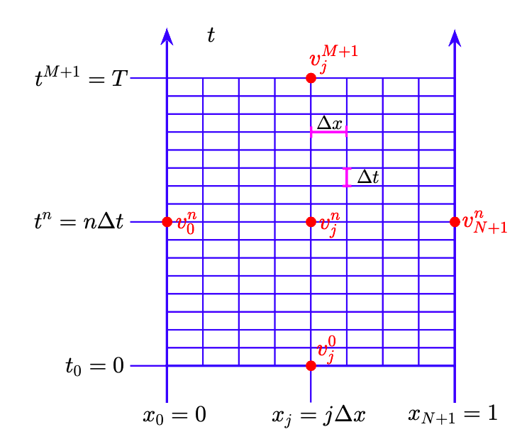



Finite Difference Method

Slide 8
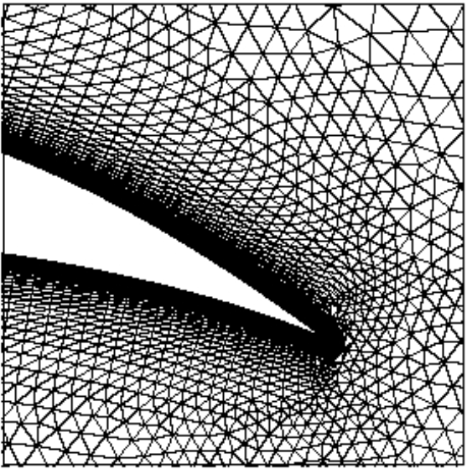


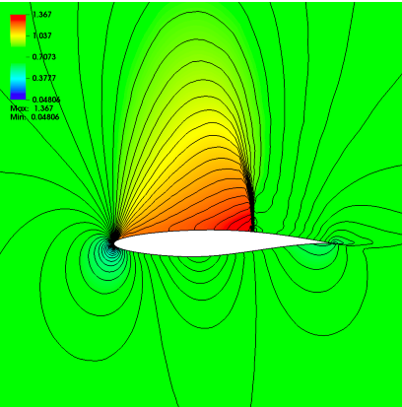
Issues
High quality mesh generation
Feasibility
High dimensional problems (computational complexity scales exponentially with dimension)
Multiple calls to a PDE solver
Optimal design
Inverse problem

Slide 9


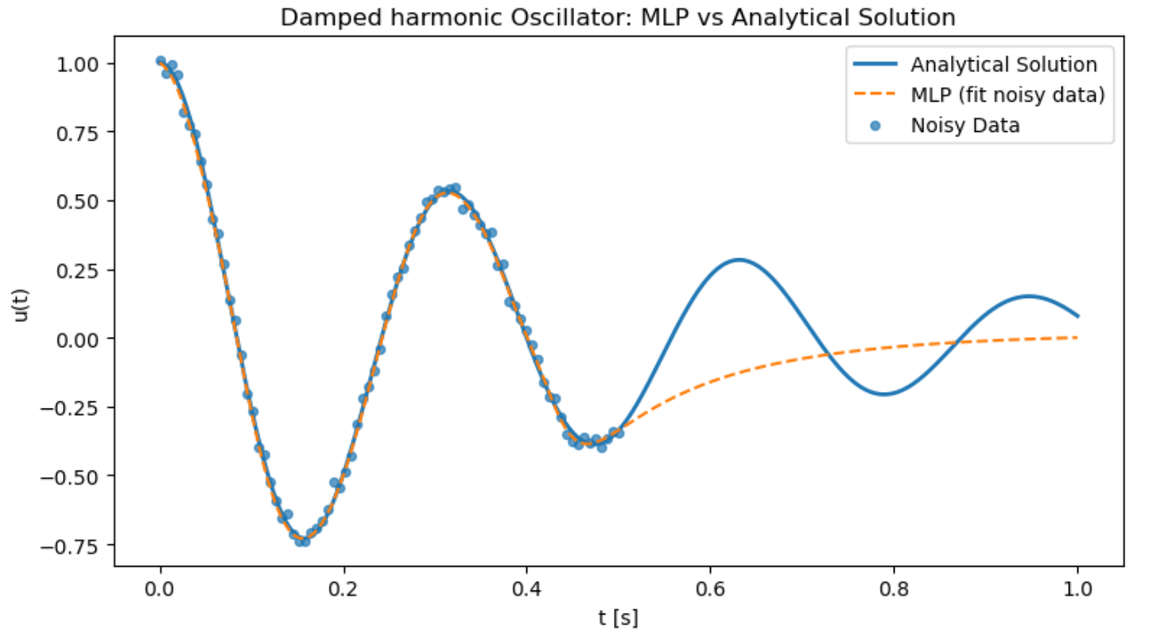
Can we solve differential equations with a deep learning approach?
Damped Harmonic Oscillator:
Machine Learning Perceptron.
3 Hiddden Layers with 32 Neurons Each.
Input/Output dimensions: 1D
80 Noisy data till t = 0.5s.
Tanh as activation function.
Learning rate 0.001.
15000 Epochs.

Slide 10

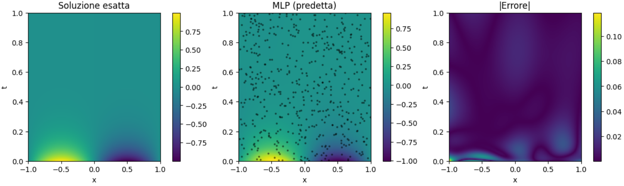
Another example
Heat Equation:
Machine Learning Perceptron.
3 Hiddden Layers with 32 Neurons Each.
Input dimensions: 2D
Output dimensions: 1D
500 Noisy data
Tanh as activation function.
Learning rate 0.001.
8000 Epochs.

Slide 11
How to improve?
uθ is the output of the neural network for parameters θ, that tries to solve the differential equation

Slide 12








How to improve?
Idea: Use the knowledge from the differential equation by adding terms to the Loss Function
Heat Equation:
Temporal Boundary Residual:
Spatial Boundary Residual:
Interior Equation Residual:
Loss Function:
Damped Harmonic Oscillator:
Temporal Boundary Residual:
Interior Equation Residual:
Loss Function:
$$L_{T}=\frac{1}{N_{TB}}\sum_{n=1}^{N_{TB}}{{\left|R_{TB1}^{θ}\right|}^{2}}+\frac{1}{N_{TB}}\sum_{n=1}^{N_{TB}}{{\left|R_{TB2}^{θ}\right|}^{2}}$$
$$L_{B}=\frac{1}{N_{TB}}\sum_{n=1}^{N_{TB}}{{\left|R_{TB}^{θ}\right|}^{2}}+\frac{1}{N_{SB}}\sum_{n=1}^{N_{SB}}{{\left|R_{SB}^{θ}\right|}^{2}}$$
$$L_{B}=\frac{1}{N_{TB}}\sum_{n=1}^{N_{TB}}{{\left|R_{TB}^{θ}\right|}^{2}}+\frac{1}{N_{SB}}\sum_{n=1}^{N_{SB}}{{\left|R_{SB}^{θ}\right|}^{2}}$$
$$L_{p}=\frac{1}{N_{INT}}\sum_{n=1}^{N_{INT}}{{\left|R_{INT}^{θ}\right|}^{2}}$$
$L_{TOT}=$ $L_{p}+L_{B}$
$L_{TOT}=$ $L_{p}+L_{T}$

Slide 13
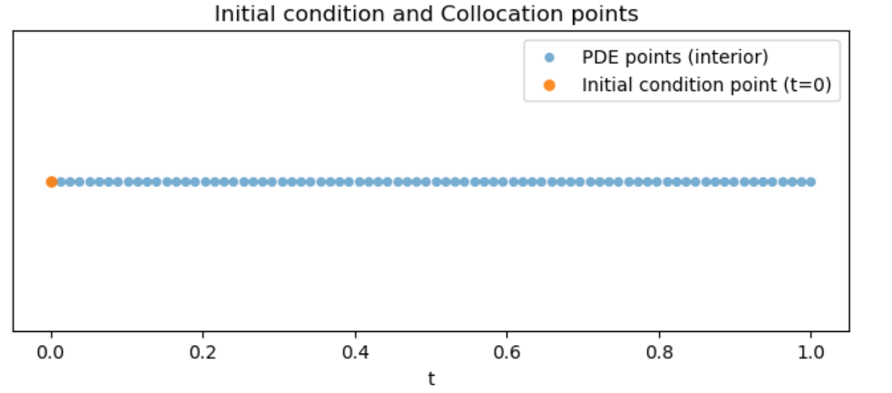
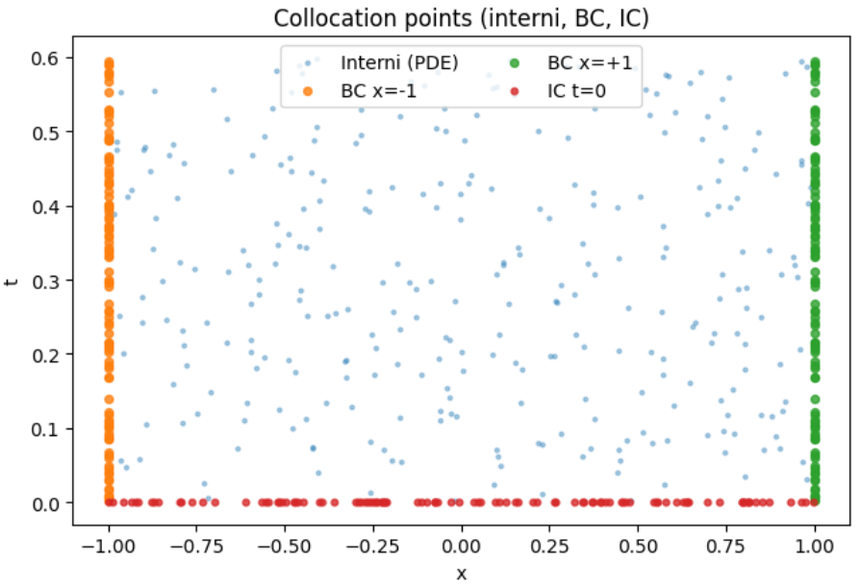
On what data we compute the physic Loss?
Idea: Generates a "random mesh" of points over the entire domain
Heat Equation:
300 Points on the spatial border for different times
100 Points for time t = 0 for different spatial coordinates
100 Points on the interior
Total of 500 points
Damped Harmonic Oscillator:
80 Points on the entire time domain

Slide 14
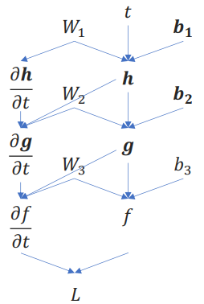


How to compute derivatives?
Extend Computational Graph
Use Back-Propagation
Find the value for parameters that minimize the Loss function
Training Loop:
Sample colocation points
Compute Network Outputs
Compute the gradients of the network with respect to the input
Compute the Loss
Compute gradients of Loss function with respect to the network parameters
Take a gradient descent step
Data are not available → Use just Physic Loss:
Data are available → Use MSE Loss and Physic Loss:

Slide 15
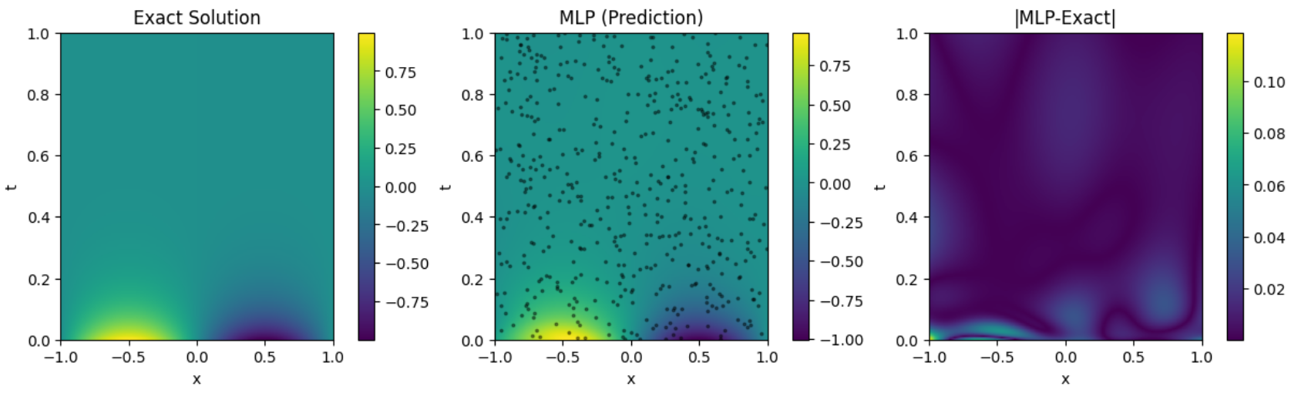
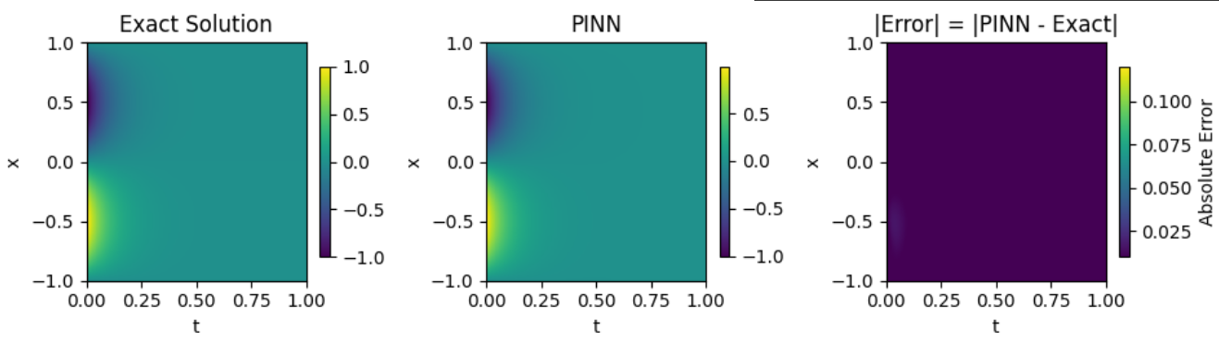
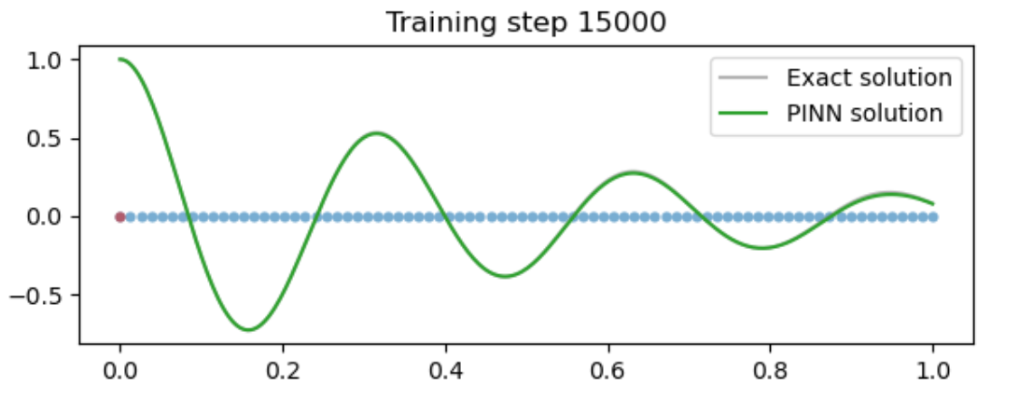
Confrontation
Same number of epochs, data/collocation points, learning rates...

Slide 16
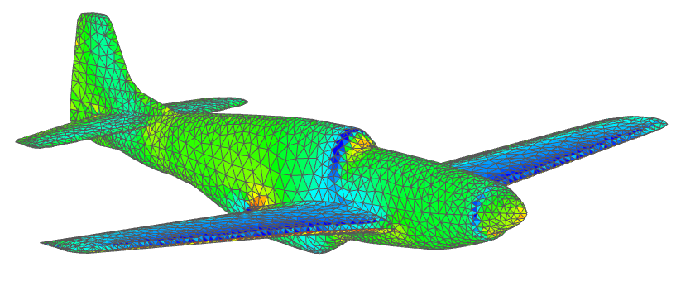
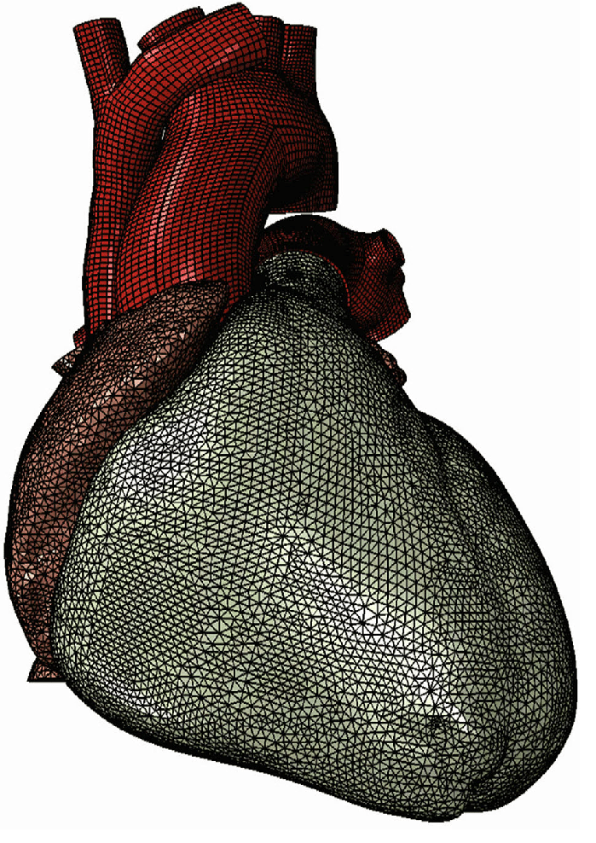
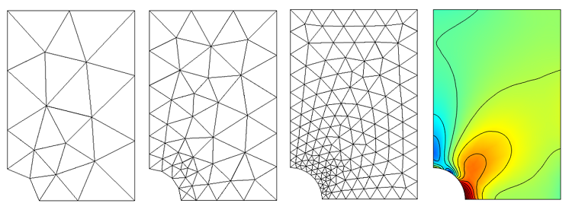
Limitations of classical numerical methods
Traditional numerical methods (Finite Element Method, Finite Difference Method, Finite Volume) are efficient but rely on domain discretization into a grid or mesh.
Low dimensions: meshes are manageable and simulations are accurate
High dimensions and/or complex Geometries:
Mesh generation becomes computationally expensive, sometimes more costly than the solver itself (D≥4)
Curse of dimensionality: Memory requirements grow exponentially with dimension
P51D Mustang Mk. III by M. Cel (http://hangar.openvsp.org/vspfiles/420) Meshed in OpenVSP and analyzed in flow5
https://www.comsol.com/blogs/meshing-considerations-linear-static-problems
Human Cardiac Function Simulator for the Optimal Design of a Novel Annuloplasty Ring with a Sub-valvular Element for Correction of Ischemic Mitral Regurgitation

Slide 17
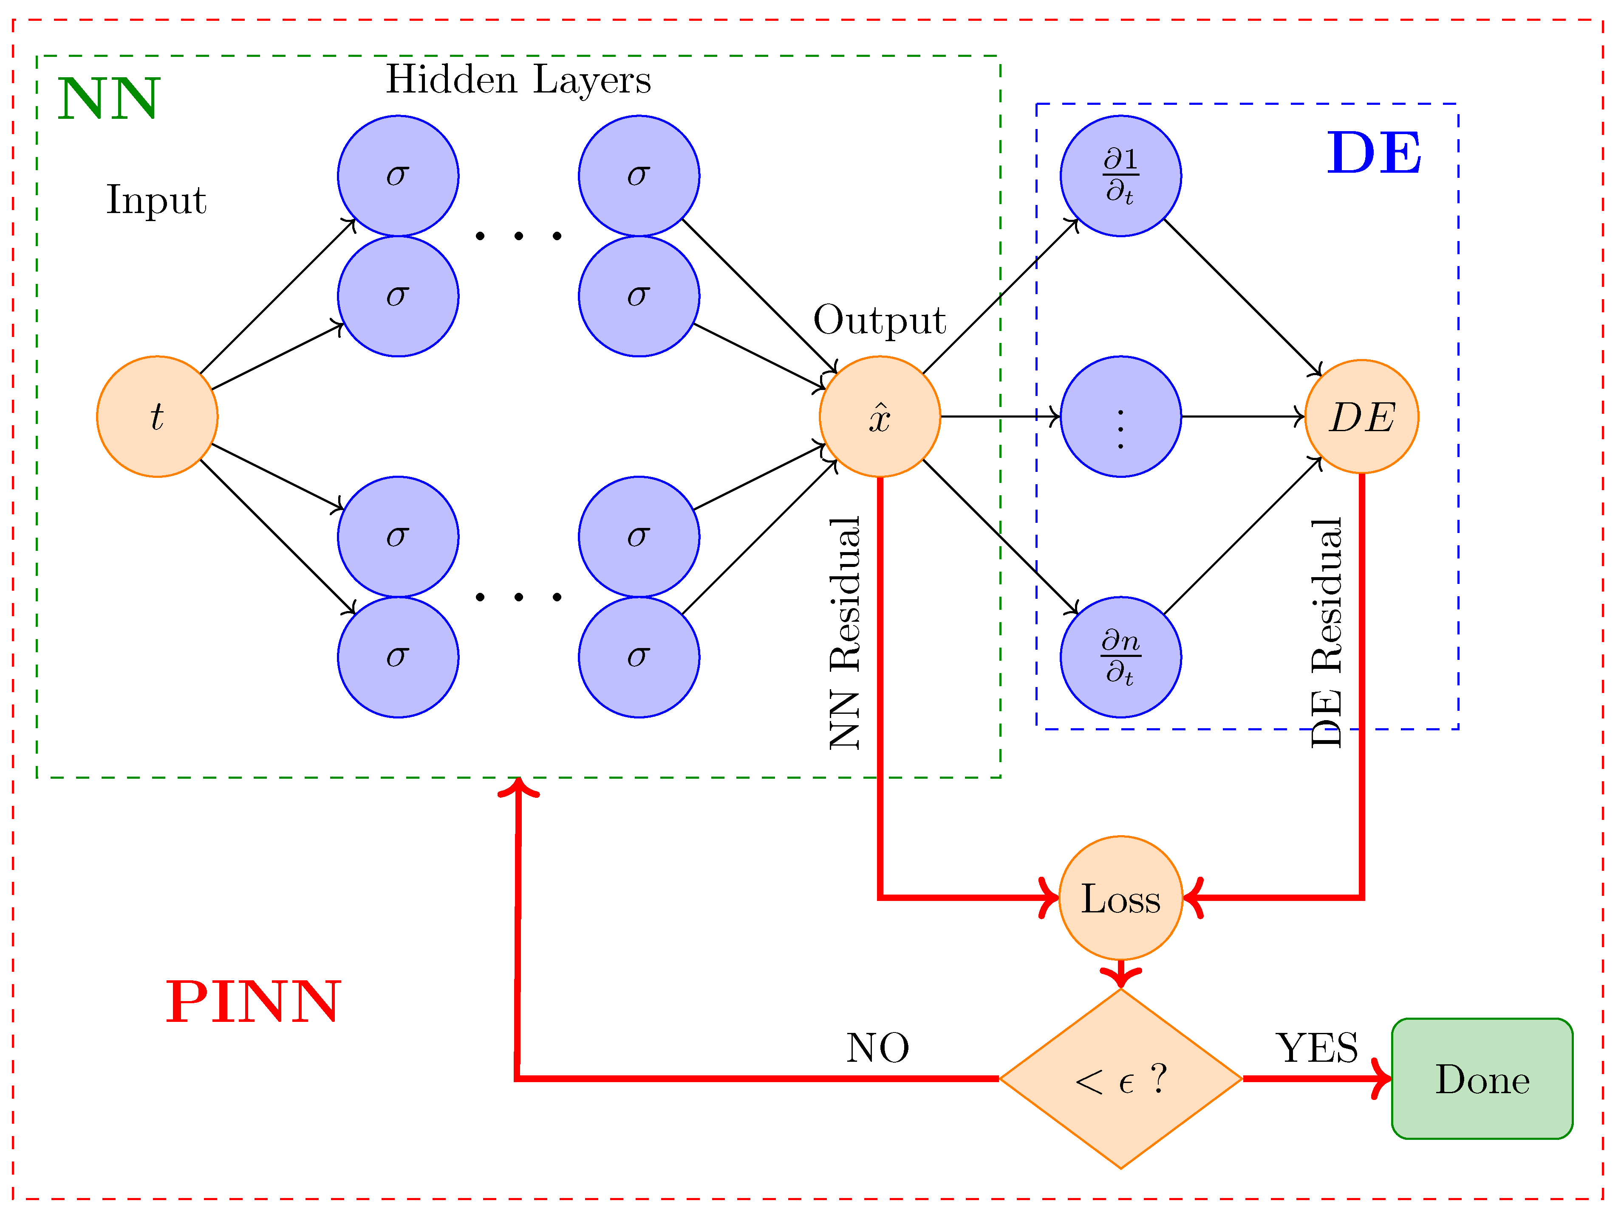
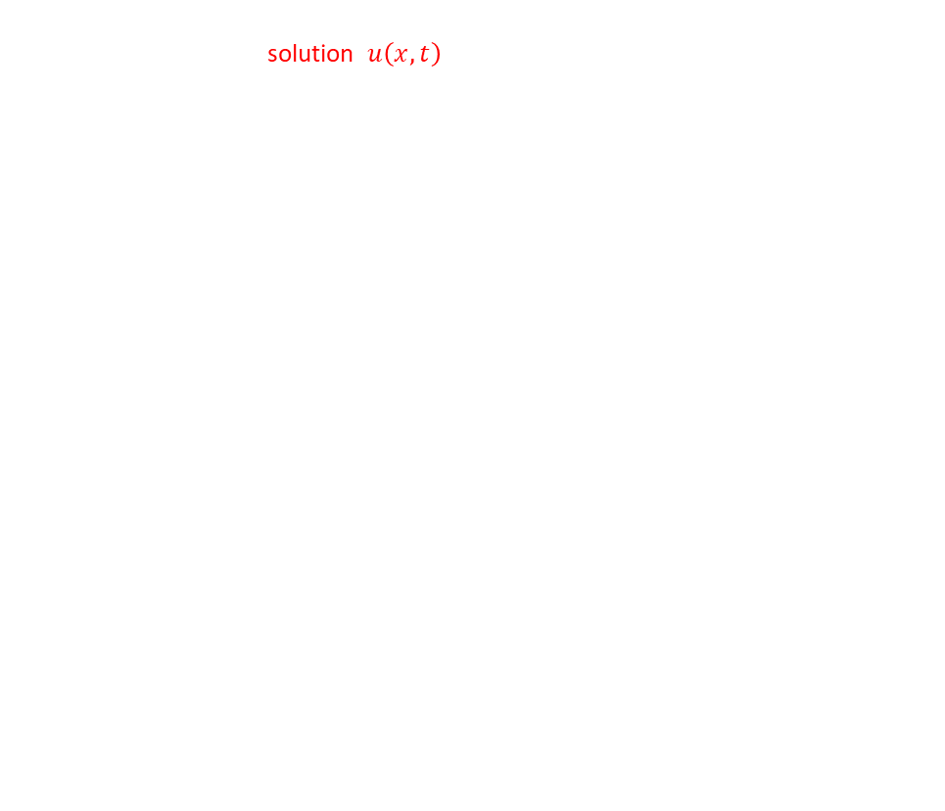
Forward Problems with PINNs
AIM: We know the PDE operator $D$ and the physical parameters $θ$, we want to compute the unknown solution $u\left(x,t\right)$
The PDE is:
$D\left[u\left(x,t\right);θ\right]=0 , \left(x,t\right) ∈ Ω$
PINN approach:
Approximate solution with NN: $u_{NN}\left(x,t;ω\right)$
Use automatic differentiation to compute PDE derivatives
Define Loss function combining physics, initial conditions and data:
$$L\left(ω\right)=λphys\left|\left|D\left[u_{NN};θ\right]\right|\right|2+λIC\left||u_{NN}−u_{0}|\right|2+λdata\left||u_{NN}−udata|\right|2$$
Output: the continuous functions $u_{NN}$ that satisfies the PDE + IC/data

Slide 18
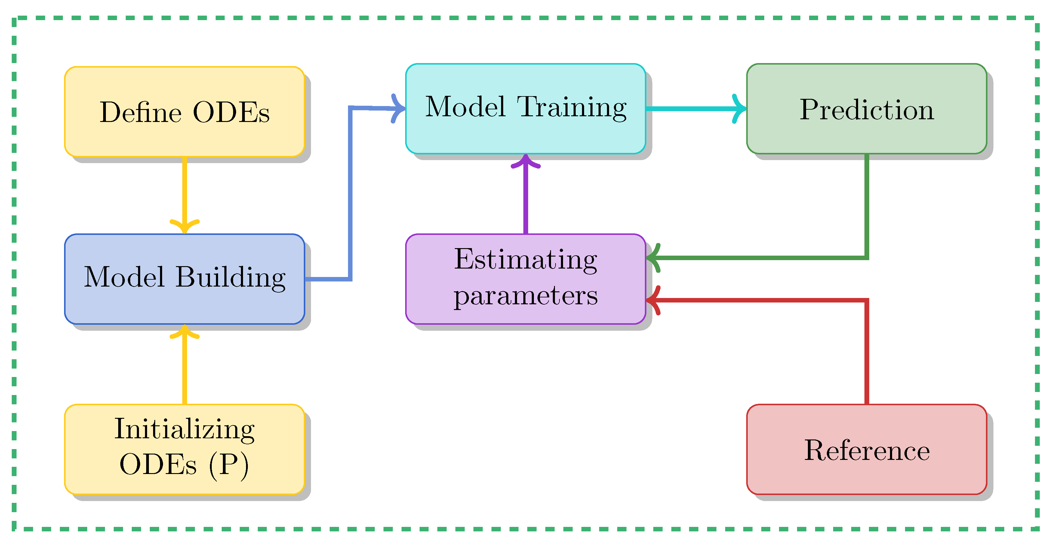
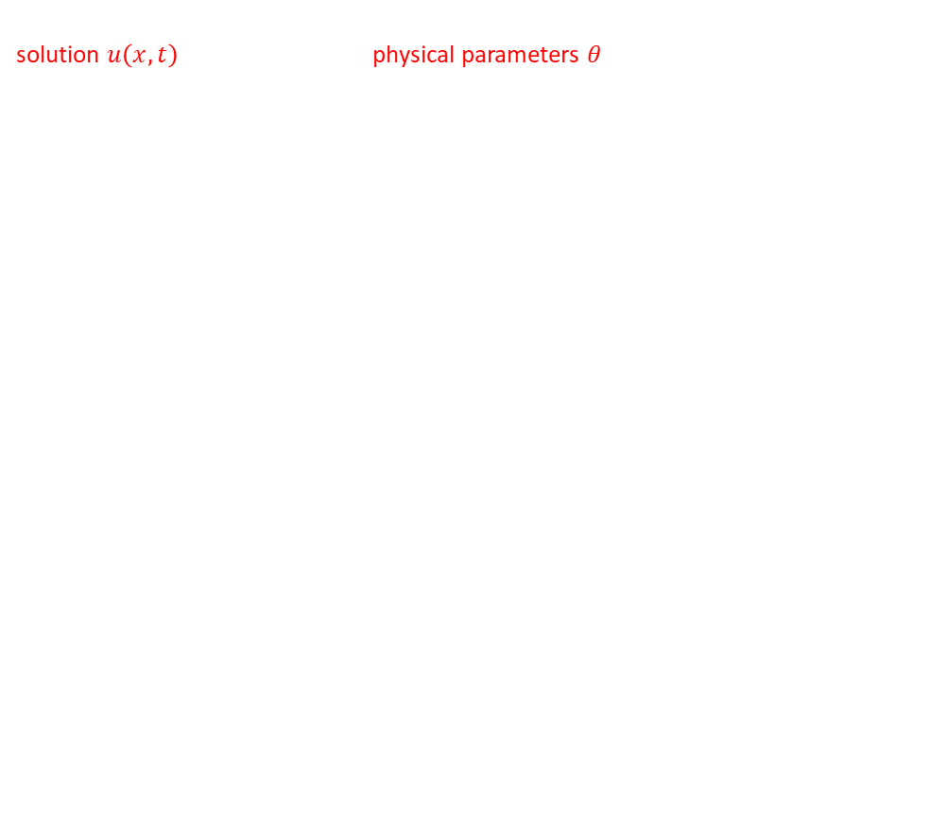
Inverse Problems with PINNs
AIM: We know the PDE operator $D$, but we want to identify both the unknown solution $u\left(x,t\right)$ and the unknown physical parameters 𝜃 of the PDE.
The PDE is:
$$D\left[u\left(x,t\right);θ\right]=0 , \left(x,t\right) ∈ Ω$$
PINN approach:
Approximate solution with NN: $u_{NN}\left(x,t;ω\right)$
Treat physical parameters θ as trainable variables (optimized together with network weights ω)
Use automatic differentiation to compute PDE derivatives
Define Loss function combining physics, initial conditions and data:
$$L\left(ω\right)=λphys\left|\left|D\left[u_{NN};θ\right]\right|\right|2+λIC\left||u_{NN}−u_{0}|\right|2+λdata\left||u_{NN}−udata|\right|2$$
Output: the continuous functions $u_{NN}\left(x,t\right)$that satisfies the PDE + IC/data and the unknown parameters 𝜃

Slide 19

Equation discovery with PINNs
AIM: We want to identify the underlying PDE D that governs the observed data $u\left(x,t\right)$
The PDE is assumed to be represented as a linear combination of candidate terms $Φ_{k}$ and $θ_{k}$are coefficients to be estimated :
$$D\left[u\right]=\sum_{k}{θ_{k}Φ_{k}\left(u,∂u,∂^{2}u,…\right)}=0$$
PINN approach:
Train NN to approximate the observed data: $u_{NN}\left(x,t;ω\right)$
Use automatic differentiation to compute spatial and temporal derivatives of $u_{NN}$
Apply sparse regression to identify the active terms and their coefficients $θ_{k}$
Define Loss function combining data fitting and physics consistency:
$$L\left(ω\right)=λphys\left|\left|D\left[u_{NN};θ\right]\right|\right|2+λdata\left||u_{NN}−udata|\right|2+λsparse\left||θ|\right|1$$
Output: the discovered PDE operator $D$ and a continuous approximation $u_{NN}\left(x,t\right)$that satisfies the PDE and the data

Slide 20
Good Features of PINNs
Why PINNs?
In principle Meshless
Can tackle a great variety of problems(will be explained later)
They require less experimental data compared to purely data-driven approaches.
Robustness to noisy data, as the physics-informed loss acts as a regularizer
Relative Easy To implement since it could be a simple MLP and there are modern frameworks like PyTorch/Tensorflow that support PINNs
Scalable to different PDEs
Scalable to dimensions and complex geometries

Slide 21
Our analysis
We trained Physics-Informed Neural Networks (PINNs) on multiple models, for each of which we addressed the forward and inverse problem.
In some case, we replicated and extended the methodology from Farea et al. (2025): Using Physics-Informed Neural Networks for Biological and Epidemiological Dynamical Systems
Giulio:
Eulero-Bernoulli
Tumor Growth Size
Michela:
SIR Model
Rita:
Gene Expression Model

Slide 22
GIULIO

Slide 23







1D-Eulero-Bernoulli Equation
The Equation:
Load Distribution:
Analytical Solution:
Loss:

Slide 24
1D-Eulero-Bernoulli Equation
Architecture:
MLP
Input dimension 1D
Output dimension 1D
#Hidden Layers: 4
#Neurons: 64
Other Hyper Parameters:
Learning rate 0.001
#Epochs: 15000
#Collocation points: 50
Physic weight 0.5
Boundary Weight 1

Slide 25
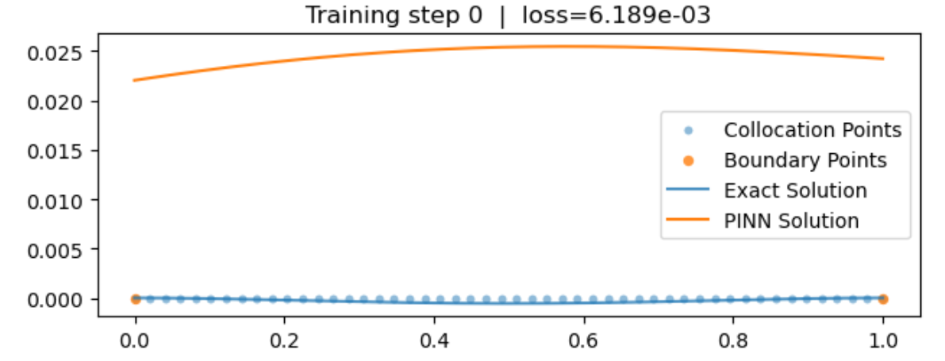
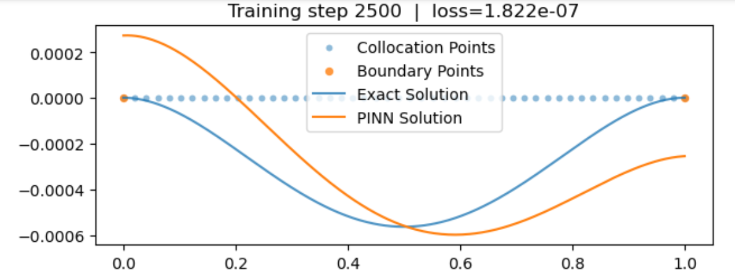
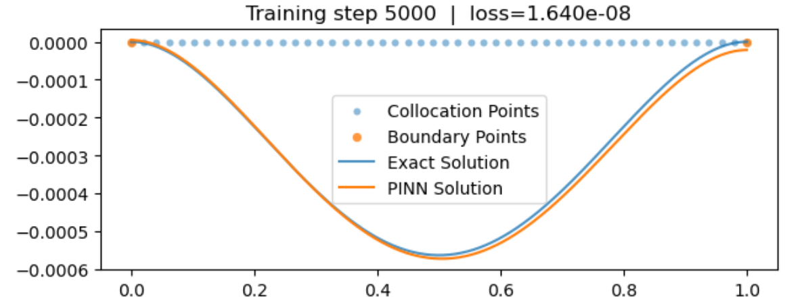
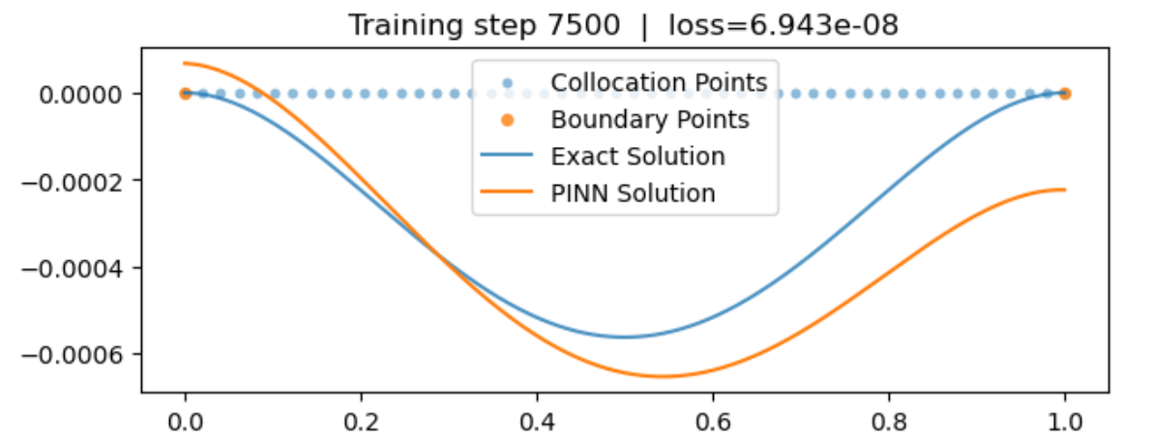
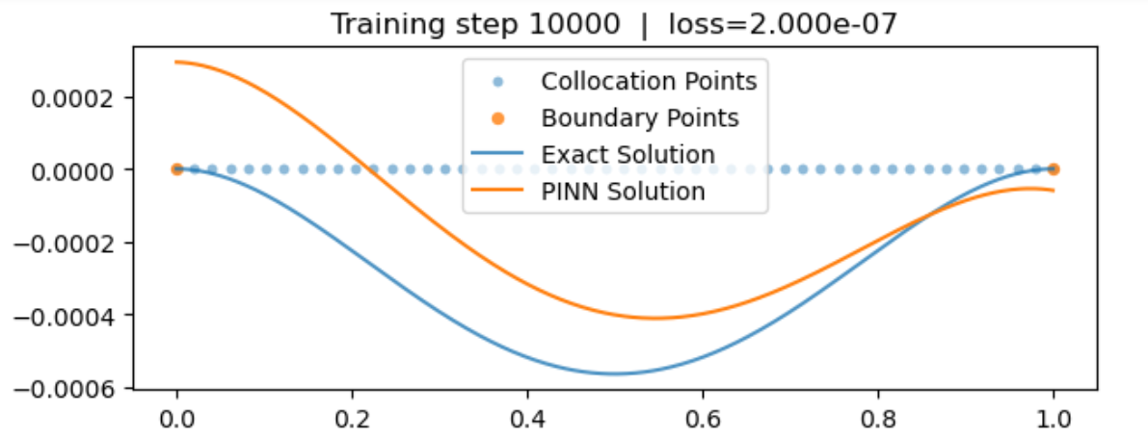
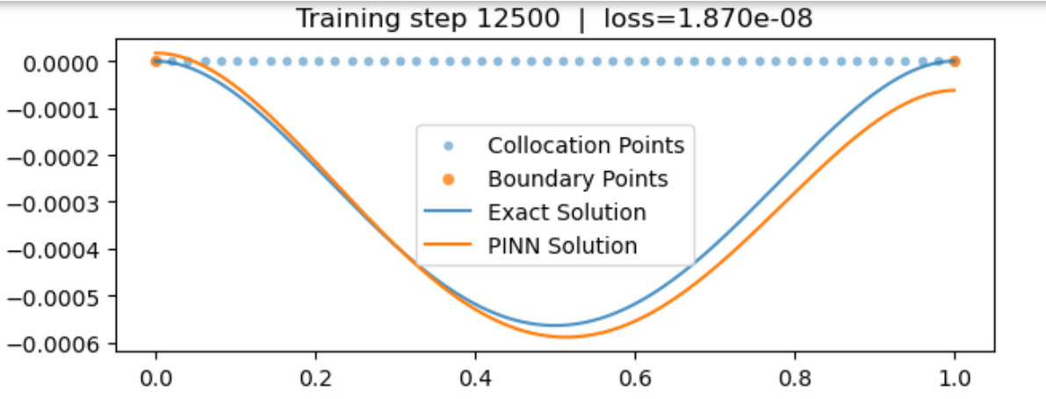
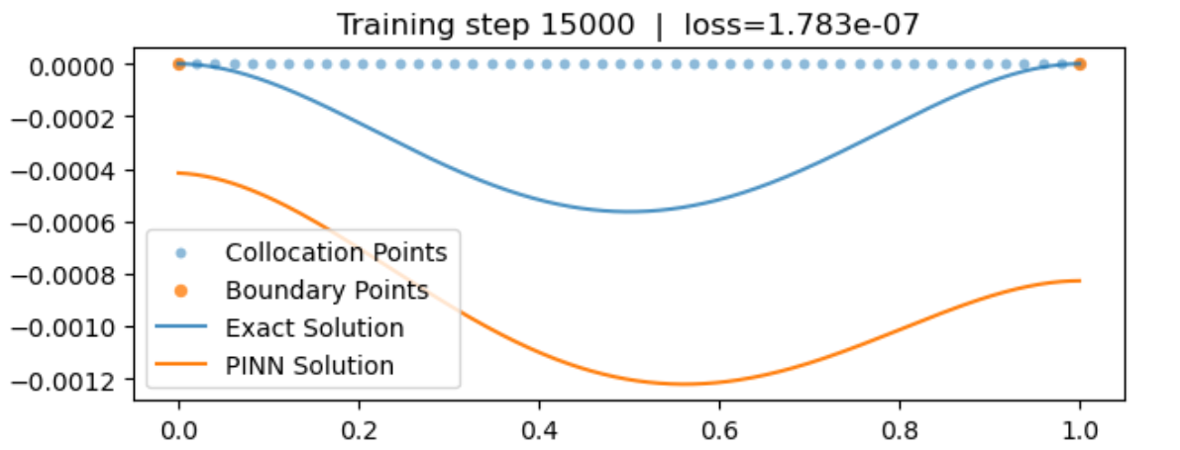
DIVERGENCE!
1D-Eulero-Bernoulli Equation

Slide 26






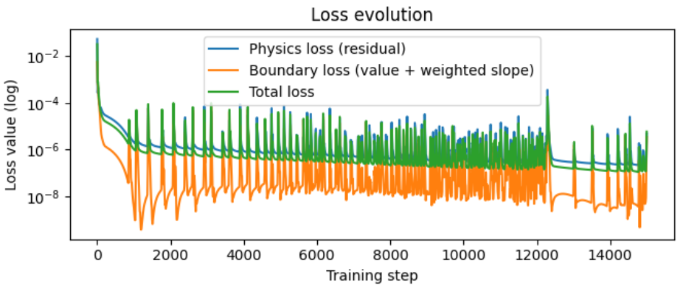
Why it diverges?
Homogeneous equation:
Space of Solutions:
Solution = Special solution + Homogeneous solution
Boundary conditions
Unique 3rd degree polynomial shift
Boundary Loss controls
Physic Loss does not "see"
, It controls only
Ill posedness of 4th derivative, sthocastic optimization
1D-Eulero-Bernoulli Equation

Slide 27

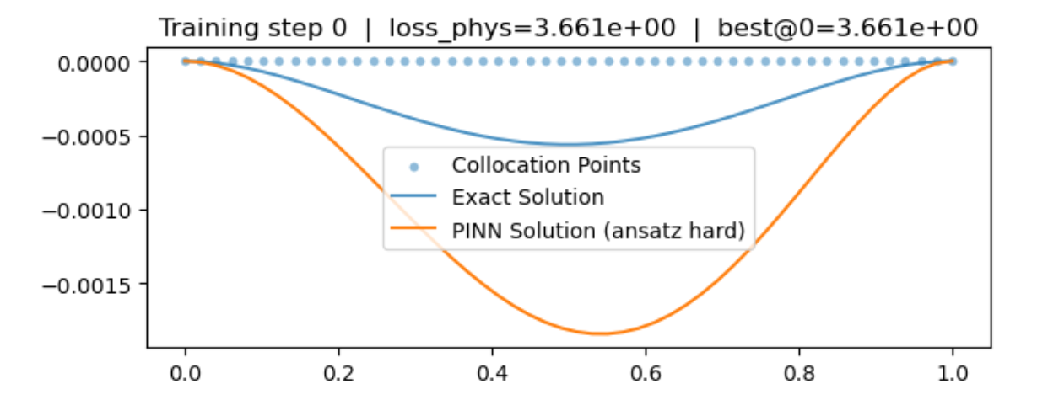
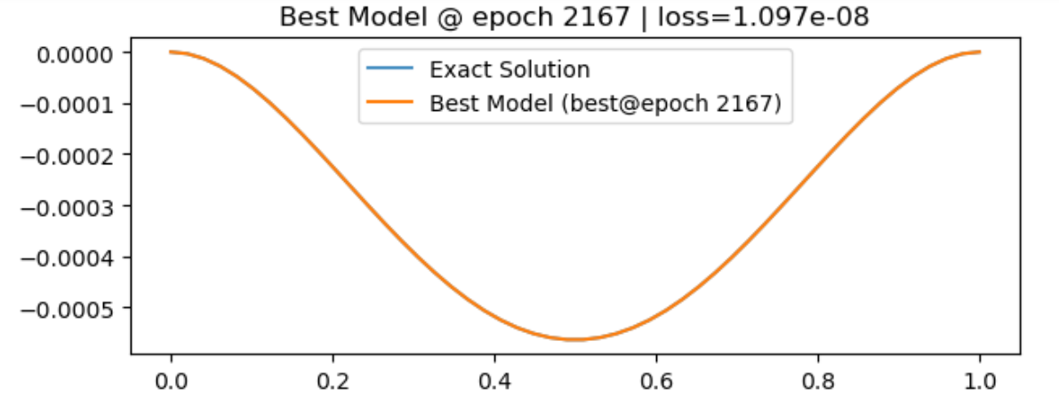
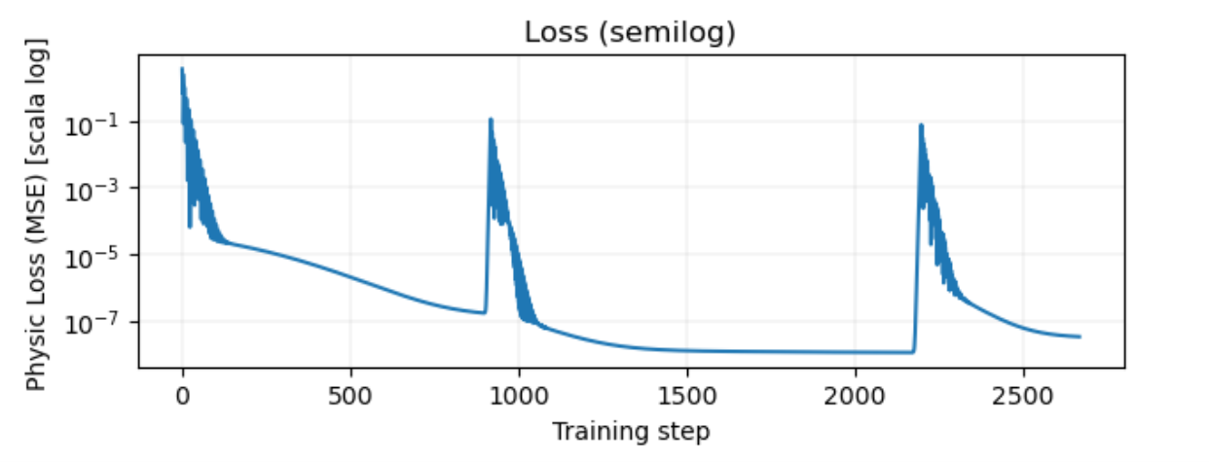
How to improve?
Architecture:
MLP
Input dimension 1D
Output dimension 1D
#Hidden Layers: 3
#Neurons: 64
Other Hyper Parameters:
Learning rate 0.001
#Epochs: Early Stopping
#Collocation points: 50
Physic weight 0.5
Boundary Weight 1
1D-Eulero-Bernoulli Equation

Slide 28
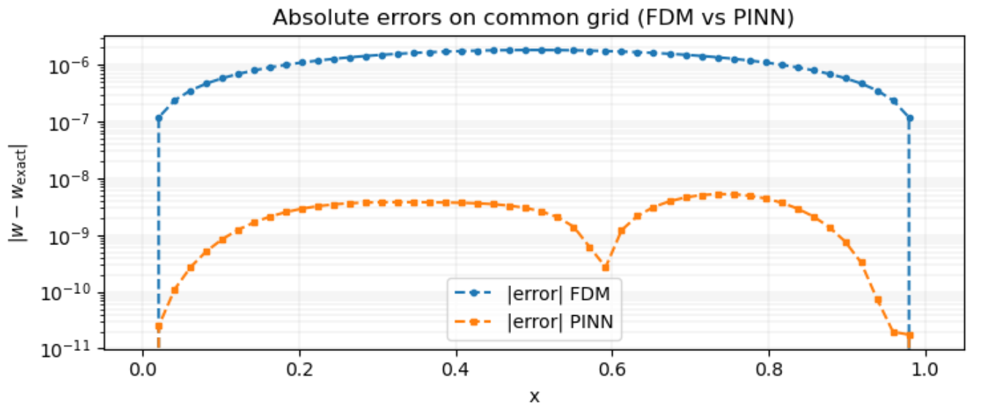
Confrontation
1D-Eulero-Bernoulli Equation

Slide 29


Tumor Growth Size
Aim: Model the tumor growth size using PINNs, make estimations on parameters
Apply the Gompertz Model with analytical solution:
Variable:
X(t) is the Tumor growth size, [X(t)] = g or mm³
Parameters
K is the carrying capacity [K] = [X(t)]
α is the growth rate [α] = t⁻¹

Slide 30


Tumor Growth Size
Part 1
Aim: Model the tumor growth size using PINNs
Architecture:
MLP
Input dimension =1D
Output dimension = 1D
#Hidden Layers = 3
#Neurons per layer = 64
Activation Function = GELU
Model Parameters:
X(0) = 1
α (alpha) = 0.3
K = 100.0
Data and Splitting:
Simulation time SIM_TIME = 50.0
Number of samples NUM_SAMPLES = 120
Dataset split: train 60% (= 72), validation 20% (= 24), test 20% (= 24)
Collocation points for physics loss: 120 (linspace on [0, 50])
t0 for IC: 0.0 (tensor shape 1×1)
Optimization:
Optimizer: Adam
Learning rate LR = 1e-3
Batch size BATCH_SIZE = 32 (≈ 3 batches/epoch with 72 training examples)
Maximum epochs EPOCHS = 1000
Early stopping patience PATIENCE = 100 (on validation MSE)
Device: CPU
Physic Weigtht: 0.3
Data Weight: 0.7

Slide 31
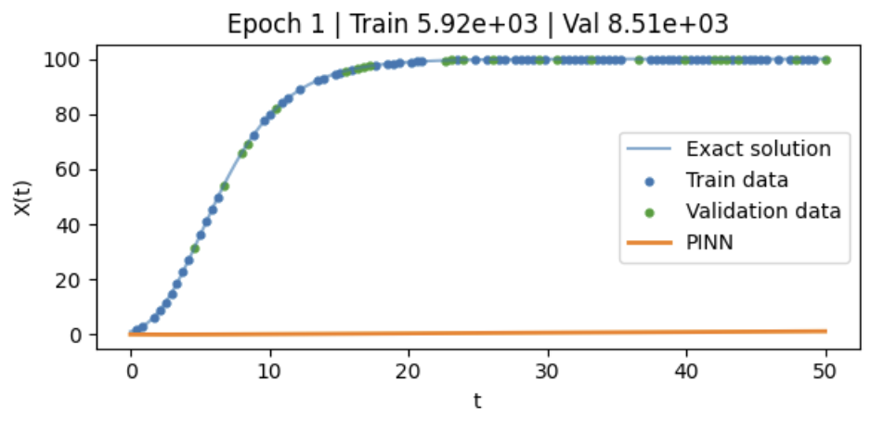
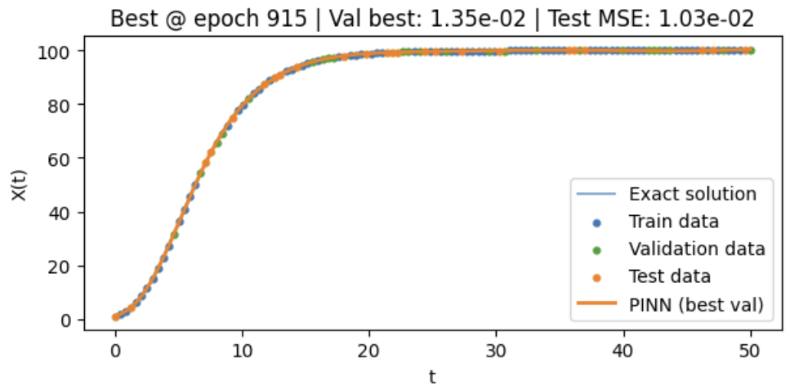
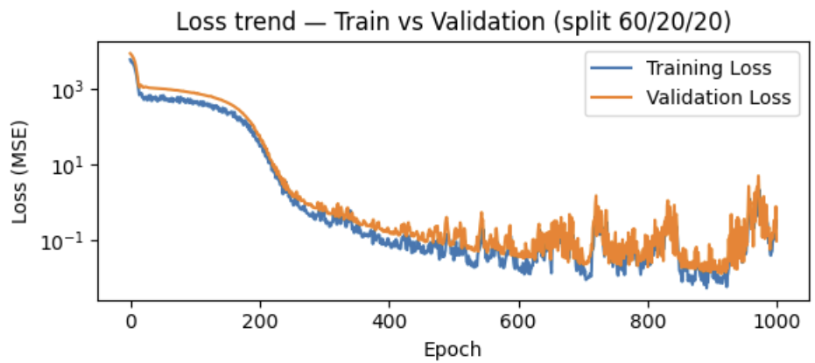
Tumor Growth Size
Part 1
Results
Test MSE (X) on best-val: 1.031e-02
Best Epoch reached on 915/1000

Slide 32
Tumor Growth Size, Part 2:
Adding Noise
Aim: Model the tumor growth size using PINNs
Architecture:
Same as before
Model Parameters:
Same as before
Data and Splitting
Same as before but with 4% of Gaussian Relative Noise
Optimization:
Same as before but now PATIENCE is 200 instead of 100 and Maximum epochs is 2000 instead of 1000

Slide 33
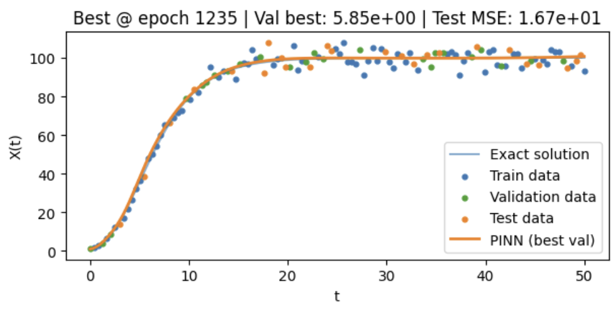
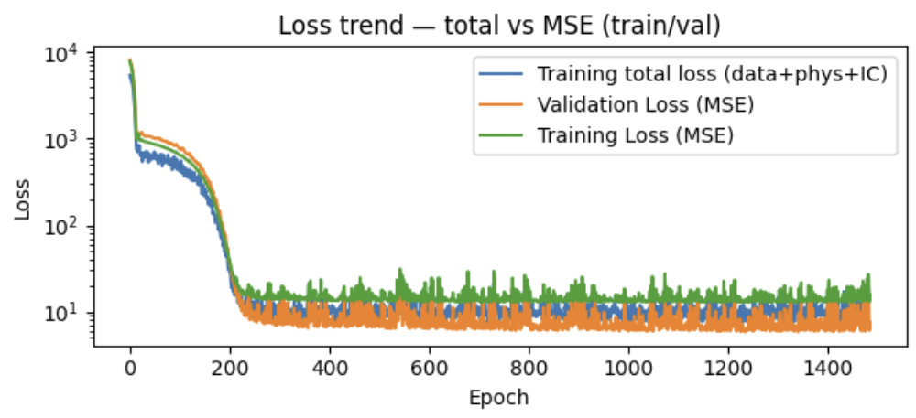
Tumor Growth Size
Part 2
Results
Test MSE (X) on best-val: 1.670e+01
Best Epoch reached on 1235

Slide 34




Tumor Growth Size, Part 3:
Therapy Term
In addition to the Gompertz model now a therapy term is applied, this new factor consists of a periodic drug administrations.
New Model:
Analytical solution:
New Model Parameters:
D = bolus dose
λ = decay constant
h = efficacy of the drug

Slide 35
Tumor Growth Size
Part 3
Therapy Term
Aim: Model the tumor growth size using PINNs
Architecture:
MLP
Input dimension =1D
Output dimension = 1D
#Hidden Layers = 4 (3)
#Neurons per layer = 128 (64)
Activation Function = GELU
Model Parameters:
X(0) = 1
α (alpha) = 0.3
K = 100.0
D = 1.0.
λ = 0.08
h = 0.5
t0_dose first bolus time = 14.0
dose_interval = 7.0
Data and Splitting
Noisy Data 4% Gaussian Relative Noise
Simulation time = 50.0
Number of samples NUM_SAMPLES = 200 (120)
Dataset split: train 60% , validation 20%), test 20%
Collocation points for physics loss: 200 (120)
t0 for IC: 0.0 (tensor shape 1×1)
Optimization:
Optimizer: Adam
Learning rate LR = 1e-3
Batch size BATCH_SIZE = 32
Maximum epochs = 5000 (1000)
Early stopping patience = 800 (on validation MSE)
Device = GPU (CPU)
Physic Weigtht: 0.5 (0.3)
Data Weight: 0.5 (0.7)

Slide 36
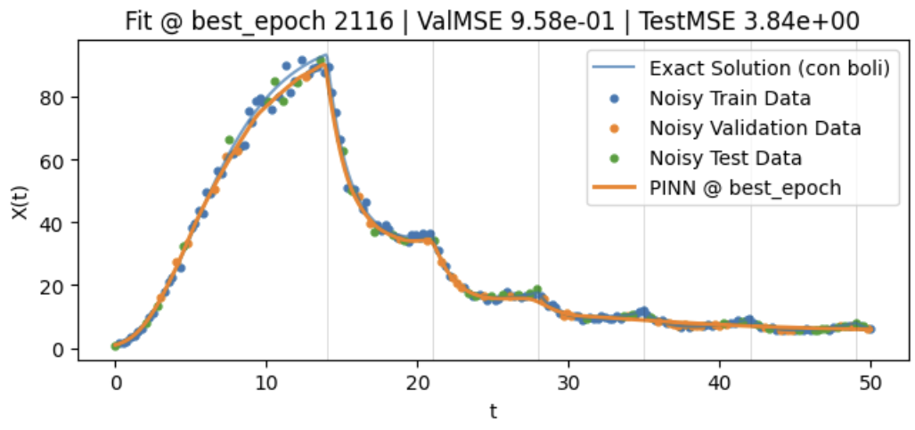
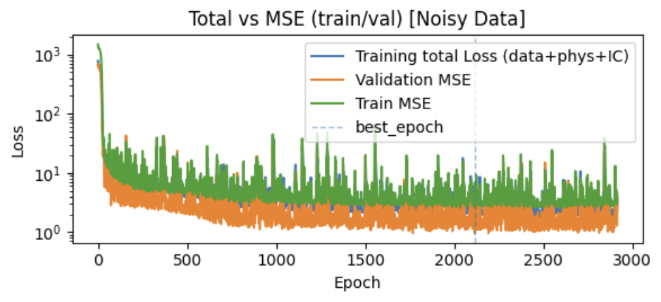
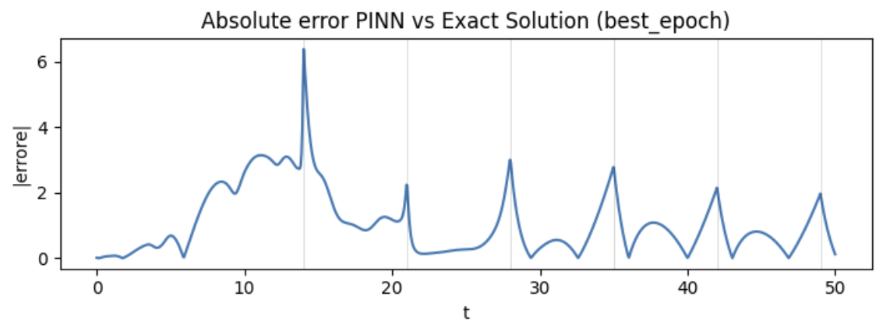
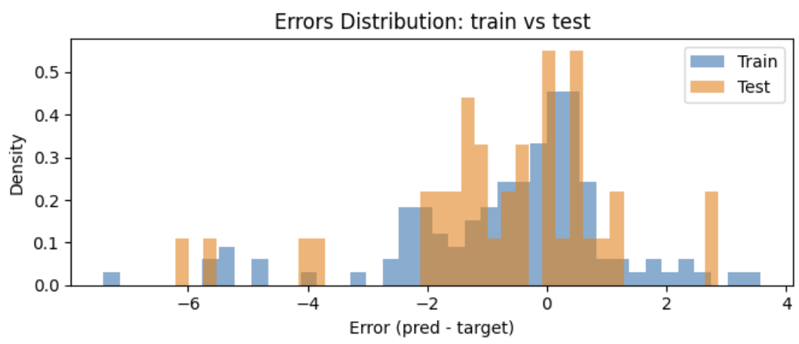
Tumor Growth Size
Part 3
Therapy Term Results
best_epoch: 2116
TRAIN MSE @ best_epoch: 3.7274e+00
VAL MSE @ best_epoch: 9.5763e-01
TEST MSE @ best_epoch: 3.842e+00

Slide 37
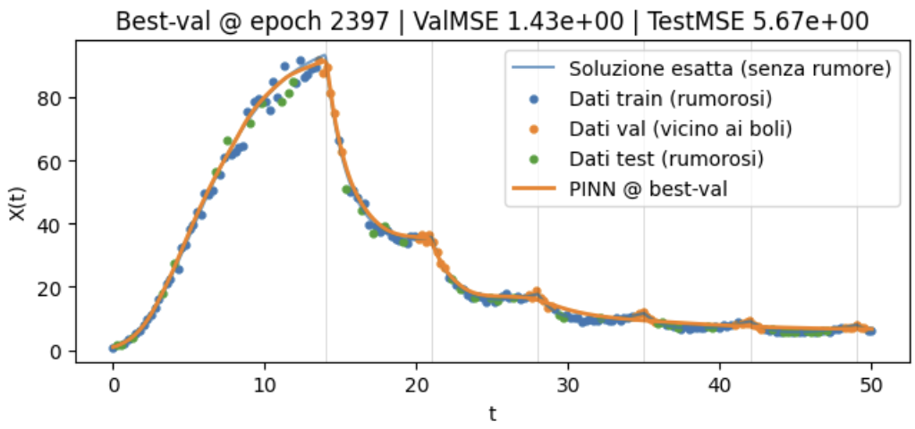
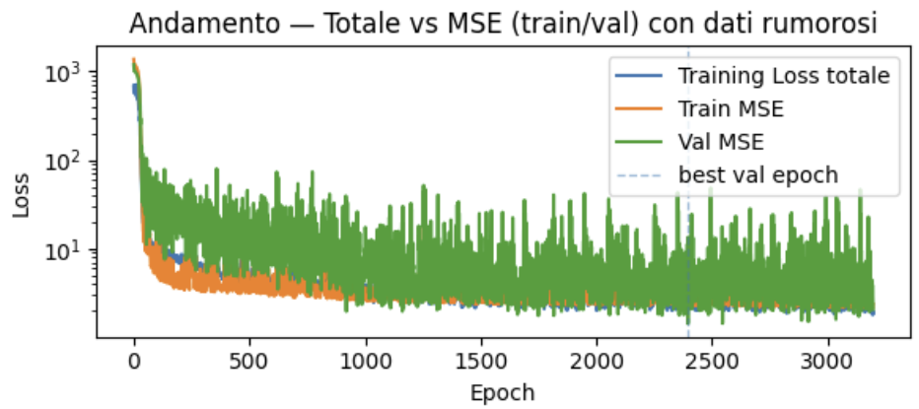
Tumor Growth Size
Part 3
Therapy Term Results
Small Modification: Validation Data on Bolus Times
Best epoch : 2397
Training loss totale : 5.404e+00
Training MSE : 3.198e+00
Validation MSE : 1.431e+00

Slide 38
Tumor Growth Size, Part 4
Inversion
Aim: Estimation of K and α parameters
Architecture:
MLP
Input dimension =1D
Output dimension = 1D
#Hidden Layers = 3
#Neurons per layer = 64
Activation Function = GELU
Model Parameters:
X(0) = 1
α (alpha) = 0.3
K = 100.0
Data and Splitting
Noisy Data 4% Gaussian Relative Noise
Simulation time = 50.0
Number of samples = 120 (120)
Dataset split: train 60% , validation 20%), test 20%
Collocation points for physics loss: 120
t0 for IC: 0.0 (tensor shape 1×1)
Optimization:
Optimizer: Adam
Learning rate LR = 1e-3
Batch size = 32 (≈ 3 batches/epoch with 72 training examples)
Maximum epochs = 1000
Early stopping patience = 800 (on validation MSE)
Device = GPU (CPU)
Physic Weigtht: 0.3 (0.3)
Data Weight: 0.7 (0.7)

Slide 39

Tumor Growth Size, Part 4
Inversion
Aim: Estimation of K α parameters
Noisy data generated with K_{TRUE} and α_{TRUE}
Learnable Parameters initialisation: K_{RAW} = 50.0 and α_{RAW}=0.743
Loss Function:

Slide 40
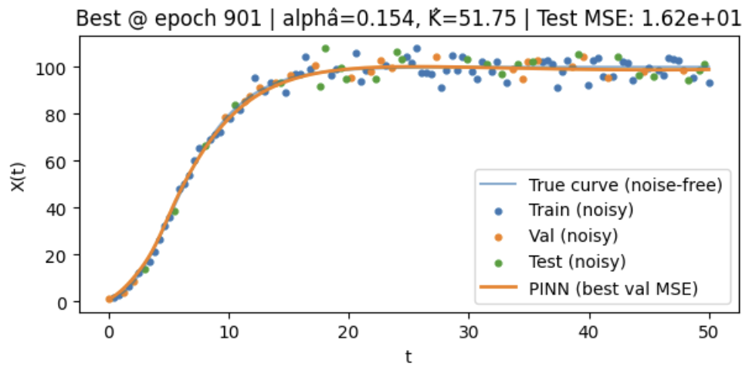
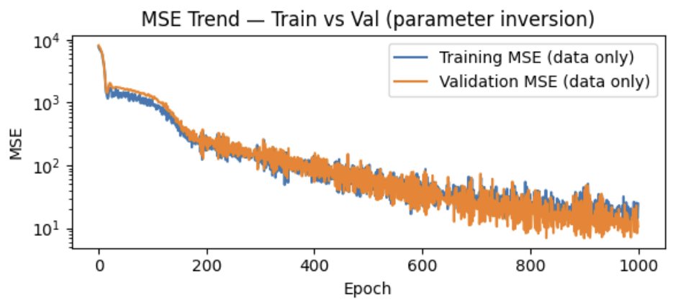
Tumor Growth Size, Part 4
Inversion
PARAMETER ESTIMATION (inversion) — best validation MSE
alpha_true = 0.3000 | alpha_raw = 0.1541
K_true = 100.00 | K_raw = 51.75
Best val epoch: 901
Test MSE (X) = 1.617e+00

Slide 41

Tumor Growth Size, Part 4
Inversion
Why there is underestimation?
With $t_{phys}$uniform on ([0,50]) and a Gompertz model with $α=0.3$, most points fall where the curve is in the plateau ⇒ $\frac{dX}{dt}\sim 0$ and $X\sim Constant$. This lead to underestimate $α$ since the physic residual is mostly seen as $r ≈−αlog⁡\left(\frac{K}{X}\right)X$
Correlation: $\frac{∂r}{∂K}=−α\frac{X}{K}$ , small if the estimation of $α$ is small $→$ the estimation of K hardly move from initial guess
Presence of Gaussian relative Noise: $E\left[{\left(X_{θ}\left(t\right)−X(t)\right)}^{2}\right]={\left(X_{θ}\left(t\right)−X(t)\right)}^{2}+σ^{2}X(t)$

Slide 42



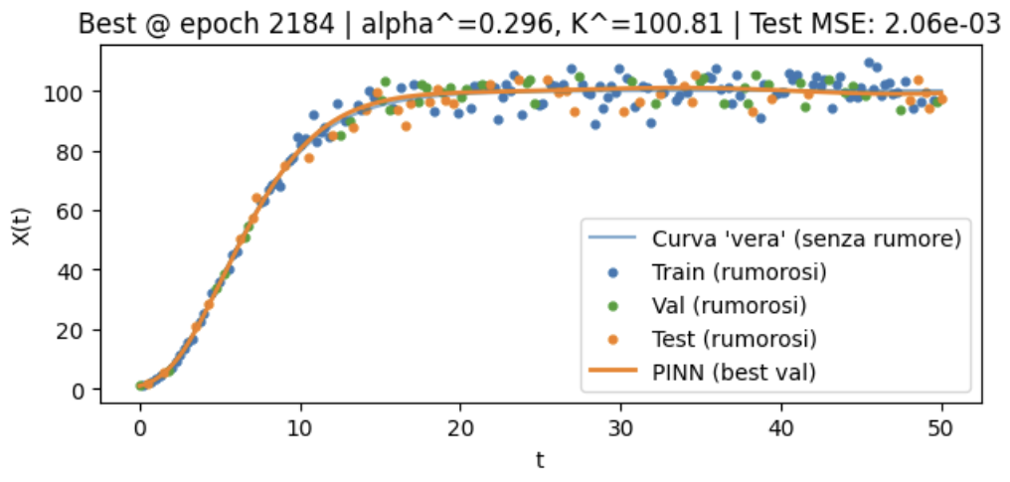

Tumor Growth Size, Part 4
Inversion, Improved
Aim: Estimation of K and α parameters
Linearize the equation:
Now the noise has constant variance 4%
Relative Errors:
$α:$ 1.3%
K: 0.81%

Slide 43

Tumor Growth Size,Part 5
Inversion with Therapy
Aim: Estimation of K, α and h parameters
Architecture:
MLP
Input dimension =1D
Output dimension = 1D
#Hidden Layers = 4 (3)
#Neurons per layer = 128 (64)
Activation Function = GELU
Optimization:
Optimizer: Adam
Learning rate LR = 1e-3
Batch size BATCH_SIZE = 32 Maximum epochs = 5000 (1000)
Early stopping patience = 800 (on validation MSE)
Physic Weigtht: 0.7 (0.3)
Data Weight: 0.3 (0.7)
Regularization Weight: 1e^-3
$$N_{θ}\left(t\right)=y(t)$$
Data and Splitting
Noisy Data 4% Gaussian Relative Noise
Simulation time = 50.0
Number of samples NUM_SAMPLES = 200 (120)
Dataset split: train 60% , validation 20%), test 20%
Collocation points for physics loss: 200 (120)
t0 for IC: 0.0 (tensor shape 1×1)
Model Parameters:
Same as before on previous therapy Tests

Slide 44

Tumor Growth Size,Part 5
Inversion with Therapy
Aim: Estimation of K α, and k parameters
Noisy data generated with K_{TRUE} and α_{TRUE} and h_{TRUE}
Learnable Parameters initialisation: K_{RAW} h_{RAW} α_{RAW}
Linearized equation: $\frac{dy(t)}{dt}=α\left(log\left(K\right)−y\left(t\right)\right)−hu(t)$
Loss: $L=λ_{MSE}L_{MSE}+λ_{IC}{\left[y_{θ}\left(0\right)−0\right]}^{2}+\frac{λ_{p}}{N}\sum_{n=1}^{N}{{\left[\frac{dy_{θ}(t_{n})}{dt}−\left(\log\left(K\right)−y_{θ}\left(t_{n}\right)\right)+hu(t_{n})\right]}^{2}}$
In case of initial guess on estimations use Regularization: $λ_{reg}{\left\|\overset{⃑}{μ}−\overset{⃑}{μ_{0}}\right\|}^{2}$ where $\overset{⃑}{μ_{0}}$ is the vector of initial guesses

Slide 45
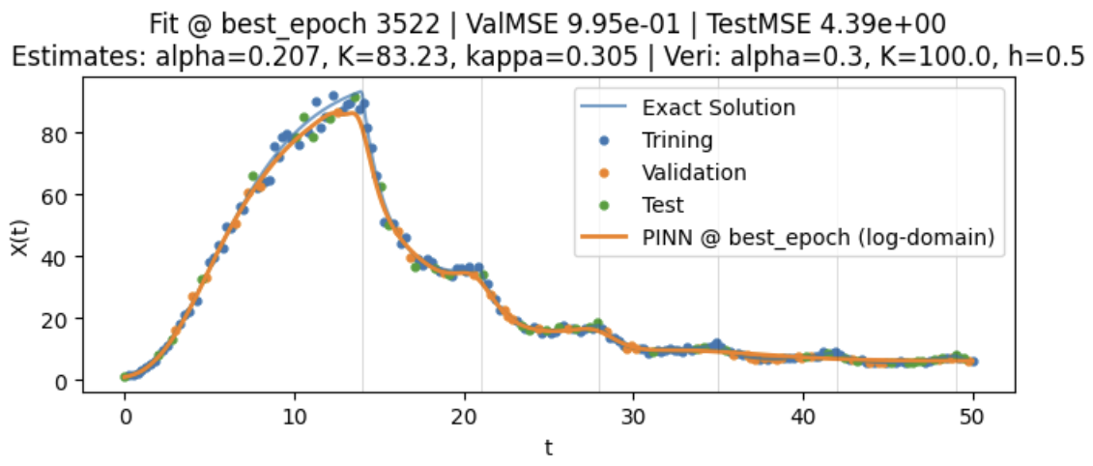
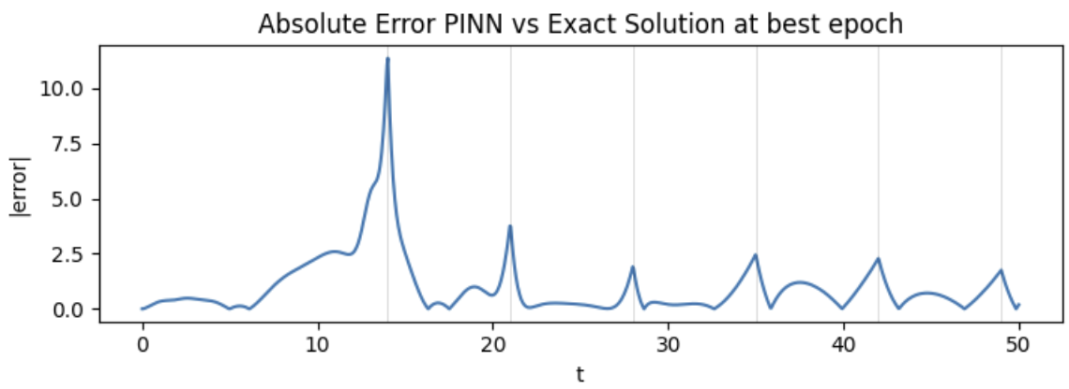

Tumor Growth Size, Part 5
Inversion with Therapy
Results
Relative Errors:
$α:$ 31%
K: 16.77%
H: 39%

Slide 46

Why the underestimation?
Few data at the plateau K=100: most of them are below $→$ underestimation of K
Correlation: $y^{′}(t)=α\left(log\left(K\right)−y\left(t\right)\right)−hu(t)→\left\{\begin{aligned}\frac{∂y^{′}}{∂α}=−\log\left(K\right)+y(t) \\ \frac{∂y^{′}}{∂K}=−\frac{α}{K} →\frac{∂y}{∂\log\left(K\right)}=−α \\ \frac{∂y^{′}}{∂h}=u\left(t\right) \end{aligned}\right.$so it’s difficult to distinguish $α$ from $K$
h’s role: The under estimation of h follows from both it’s role in the model and the underestimation of K
Collocation points: the contribute of h is given when $u\left(t\right)$ is high, so it’s mostly given around the $t_{n}$. Few collocation points $→$ bad estimate of h
Loss MSE on X(t): Train the PINN to predict y, find X = exp(y), compute the Validation Loss MSE
$$∆y=y_{θ}−y=y_{θ}−\log\left(x\right) → X_{θ}=X+X∆y → ∆X=X∆Y$$

Slide 47
Tumor Growth Size,Part 5
Inversion with Therapy improved
Aim: Estimation of K α, and h parameters
Architecture:
MLP
Input dimension =1D
Output dimension = 1D
#Hidden Layers = 4 (3)
#Neurons per layer = 512 (64)
Activation Function = GELU
Optimization:
Optimizer: Adam
Learning rate LR = 1e-3
Batch size BATCH_SIZE = 32 Maximum epochs = 5000 (1000)
Early stopping patience = 800 (on validation MSE)
Physic Weigtht: 0.4 (0.3)
Data Weight: 0.6 (0.7)
Regularization Weight: 1e^-3
Data and Splitting
Noisy Data 4% Gaussian Relative Noise
Simulation time = 50.0
Number of samples NUM_SAMPLES = 250 (120)
Dataset split: train 60% , validation 20%), test 20%
Collocation points for physics loss: 1000 (120)
t0 for IC: 0.0 (tensor shape 1×1)
Model Parameters:
Same as before on previous therapy Tests

Slide 48
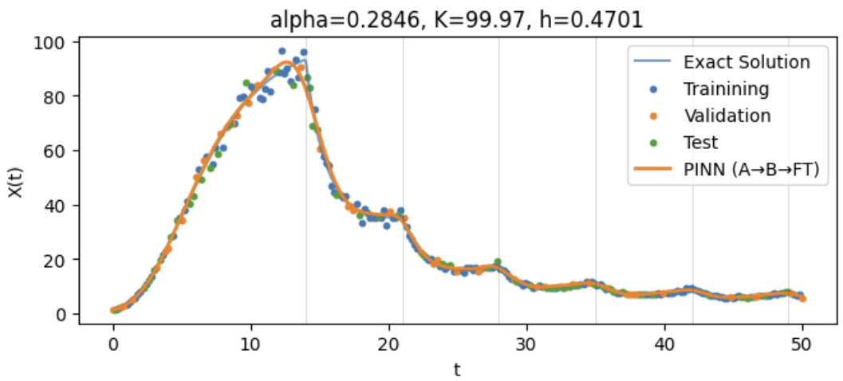

Tumor Growth Size, Part 5
Inversion with Therapy
Results
[TEST] MSE(X)=5.702 ⇒ RMSE ≈ 2.39 ⇒ 2%-3% of relative error, so less than the Noise
Relative Errors:
$α:$ 5.1%
K: 0.03%
H: 6%

Slide 49
MICHELA

Slide 50
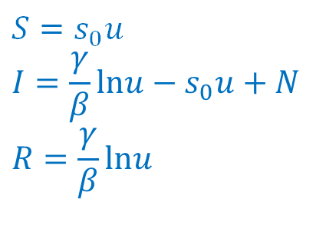
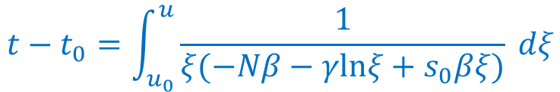



SIR model
Susceptible, Infected, Recovered
$$\frac{dS}{dt}=−βSI$$
$$\frac{dI}{dt}=βSI−γI$$
$$\frac{dR}{dt}=γI$$
$S\left(t\right), I\left(t\right), R\left(t\right)≥0$ $∀t∈[0,T]$
$$S\left(t\right)+I\left(t\right)+R(t)=N ∀t∈[0,T]$$
Exact solution with parameter
$$u(t)=e^{−\frac{β}{γ} R(t)}$$
$$u(0)=u_{0}e^{−\frac{β}{γ} R(0)}$$
$$S=s_{0}u$$
$$I={\frac{γ}{β}lnu−s}_{0}u+N$$
$$R=\frac{γ}{β}lnu$$
$$t−t_{0}=\int_{u_{0}}^{u}{\frac{1}{ξ(−Nβ−γlnξ+s_{0}βξ)} dξ}$$

Slide 51
Sir model
**NN features**
* INPUT_DIM=1
* HIDDEN_LAYERS=3
* HIDDEN_DIMS=100
* OUTPUT_DIM=3
* ACTIVATION_FN=nn.Tanh
* LEARNING_RATE=1e-3
***
* SIMULATION_TIME=100.0
* NUM_SAMPLES=120
* BATCH_SIZE=32
* EPOCHS=10000
* EPOCH_INTERVAL=500
* PATIENCE=500
* split 60% train, 20% validation, 20% test
* noise with standard deviation 0.1 in synthetic data
PINN (softmax)
Synthetic data (odeint, noise, normalization)
Collocation and IC points (dense)
Split in training, validation and test set
Training
Validation
Early stopping
**Collocation and ic points**
* N_f=2000
* N_ic=5
* dense_until=30.0
* dense_frac=0.6
* ic_span=0.5

Slide 52


SIR model - losses
$$t^{′}=\frac{t}{T}$$
$$\frac{d}{dt^{′}}=T\frac{d}{dt}$$
$$f_{S}=\frac{dS}{dt}−T(−βSI)$$
$$f_{I}=\frac{dI}{dt}−T(βSI−γI)$$
$$f_{R}=\frac{dR}{dt}−T(γI)$$
$${loss}_{ph}=E\left[{f_{S}}^{2}\right]+E\left[{f_{I}}^{2}\right]+E\left[{f_{R}}^{2}\right]$$
$${loss}_{d}=MSE\left(pinn\left(t_{b}\right)−y_{b}\right)$$
$${loss}_{ic}=MSE(pinn\left(t_{ic}\right)−y_{ic})$$
$${loss=λ_{d}{loss}_{d}+λ_{ic}{loss}_{ic}+λ_{ph}loss}_{ph}$$

Slide 53
SIR models -- A COMPARISON
Activation function | Learning rate | Loss parameters (λd,λic,λph) | Best epoch | Best validation loss
Tanh | 1e-3 | (1,1,1) | 1750 | 6e-3
Tanh | 1e-3 | (1,0.8,0.8) | 2671 | 6e-3
Sigmoid | 1e-3 | (1,1,1) | 3652 | 0.2
Selu | 1e-4 | (1,1,1) | 950 | 8e-3
PAPER Tanh | 1e-4 | (0.7,/,0.3) | 2500 | 8e-4

Slide 54



testing
training

Slide 55



Slide 56


GENE EXPRESSION MODEL
Gene expression can be described by a system of ODEs where mRNA (M) is produced by transcription and degraded, while Protein (P) is produced by translation and degrade:
$\left\{\begin{matrix}\frac{ⅆM}{ⅆt}=k_{m}⋅PN−γ_{m}M \\ \frac{ⅆP}{ⅆt}=k_{p}⋅M−γpP\end{matrix}\right.$ , where:
Variables:
M: mRNA concentration
P: Protein concentration
Goal: Use Physics-Informed Neural Networks (PINN) to:
Learn trajectories (M(t),P(t)) from noisy/sparse data (Forward problem)
Estimate unknown parameters (Inverse problems)
Parameters:
$k_{m}$, $k_{p}$: transcription/translation rates
$γ_{m}$, $γp$ : degradation rates
PN: promoter copy number

Slide 57
RITA

Slide 58

Synthetic Data and PINN Setup
Synthetic data generation:
Ground truth parameters: $k_{m}$= 0.6, $k_{p}$= 0.9, $γ_{m}$= 0.4 $γp$= 0.5, PN=50, M₀=P₀=1
Simulated with RK4, final time T=50, 400 points.
Observations: 25% randomly sampled, with Gaussian noise σ=0.02
Split: 60% train, 20% validation, 20% test
Time normalization to [0,1]
PINN architecture:
MLP with input 1D, 2 hidden layers, 128 neurons each, output 2D
Activation: GELU
Output: [M(t),P(t)]
Positivity enforced via Softplus
Xavier initialization for the weights

Slide 59

Training
Combined Loss with physics, initial conditions and data:
$$L\left(ω\right) =λphys\left({\left\|R_{M}\right\|}^{2}+{\left\|R_{P}\right\|}^{2}\right)+λIC\left(\left\|M_{NN}\left(0\right)−M_{0}\right\|2+\left\|P_{NN}\left(0\right)−P_{0}\right\|2 \right)$$
$$+λdata(\left\|M_{NN}−M_{data}\right\|2+\left\|P_{NN}−P_{data}\right\|2)$$
The residuals are:
R_{M}= $\frac{dMNN}{ⅆt}−\left(k_{m}⋅PN−γ_{m}MNN\right)$ R_{P}= $\frac{dPNN}{ⅆt}−\left(k_{p}⋅PN−γ_{p}PNN\right)$
Setup:
The optimizer: Adam, learning rate= ${10}^{−3}$
Early stopping with validation set

Slide 60


Forward Problem - Learning trajectories
Setup:
Parameters fixed to ground truth
Network only learns trajectories from noisy sparse data
Loss weights: $λdata$=0.4, $λphys$=0.6, $λIC$=1
Epochs: 2500
Results:
PINN accurately reconstructs 𝑀(𝑡) and 𝑃(𝑡) across full time domain
Physics residuals improve extrapolation to unseen time intervals
Loss curves show convergence with balanced data/physics weighting
Comparison to paper:
Similar reconstruction quality, but GELU activation improved training stability

Slide 61



Inverse Problems - Learning traj/parameters
All parameters learnable:
Trainable: $k_{m}$, $k_{p}$, $γ_{m}$, $γp$, PN
Network learns trajectories and parameters from noisy sparse data
Loss weights: $λdata$=0.7, $λphys$=0.3, $λIC$=1
Epochs: 10000, early stopping: 600
Issue: $k_{m}$and PN are not independently identifiable
PN fixed:
PINN accurately reconstructs 𝑀(𝑡) and 𝑃(𝑡) across full time domain
It removes identifiability issue
Training faster and more robust

Slide 62


